Slide 1

Reasonable Accommodation and the ADA: How to Identify and Correctly Engage in the Interactive Process
ROE LAW GROUP
www.roelawgroup.com
60 South Sixth Street, Suite 2630 612-351-8305 (direct)
Minneapolis, MN 55402 612-810-1807 (cell)
jroe@roelawgroup.com 612-351-8301 (fax)

Slide 2

THE ADA
The Americans with Disabilities Act (ADA) covers all employers of 15 or more employees and prohibits discrimination in employment practices, such as hiring, firing, advancement and compensation, and other terms, conditions, and privileges of employment. It also protects employees from retaliation when they enforce their rights under the ADA.
The Equal Employment Opportunity Commission (EEOC) is the federal agency responsible for enforcing the ADA at the federal level. Many states have similar laws that protect employers with fewer than 15 employees.
2

Slide 3


What the ADA Protects
The ADA protects individuals with disabilities, meaning those who: (a) have a physical or mental impairment that substantially limits one or more major life activities; (b) have a record of such an impairment; or (c) are regarded as having such an impairment
3

Slide 4

WHAT IS A REASONABLE ACCOMMODATION?
Any modification or adjustment to a job or work environment that will enable a person with a disability to apply or perform the job

Slide 5

Preparing For An Accommodation Request?
Ensure job positions have defined essential and nonessential functions.
Draft or review all job descriptions to ensure accurate descriptions of actual job duties and
Identify the essential and nonessential job responsibilities.
Ensure you have policies and a process to handle accommodation requests
5

Slide 6

Requests for Accommodation
According to the EEOC, an individual may use “plain English” and need not mention the ADA or use the phrase “reasonable accommodation” when requesting an accommodation.
Therefore, any time an employee indicates that they are having a problem and the problem is related to a medical condition, the employer should consider whether the employee is making a request for accommodation under the ADA.

Slide 7


Examples of Reasonable Accommodation

Slide 8
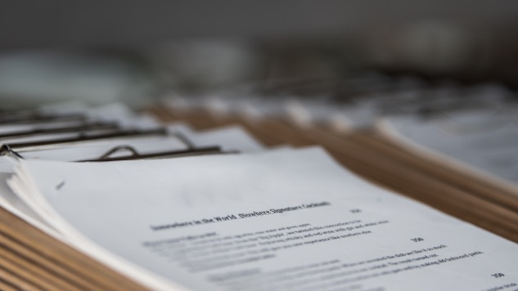
…When Hiring
Written materials
Providing readers or sign language interpreters
Ensuring that recruitment, interviews, tests, and other components of the application process are held in accessible locations
Providing or modifying equipment or devices
Adjusting or modifying application policies and procedures

Slide 9


… During Employment
Making existing facilities accessible;
Modifying work schedules, positions, acquiring or modifying equipment; and
Providing qualified readers or interpreters

Slide 10
What To Do When You Receive An Accommodation Request
In every case, engage in (and document) an interactive process with the affected employee to identify any potential reasonable accommodation.
IMPORTANT: Make sure HR is involved in all accommodation requests and throughout the interactive process!
Request information about why an accommodation is needed.

Slide 11

What To Do When You Receive An Accommodation Request (cont’d)
How you request this information:
  Get it in writing.
  Approve pending formal documentation at a later date.
  Accept information from a past medical visit.
  Explore a short-term accommodation, identifying start and end dates.

Slide 12

What To Do When You Receive An Accommodation Request (cont’d)
The Interactive Process:
  Discuss with the employee the limitations or performance issues
  Engage in an open dialogue with the employee about the requested accommodation.
  Ensure that this interactive dialogue is properly documented, including any modifications to the accommodation or follow-up discussions.

Slide 13


Six Practical Considerations for Managers under the ADA

Slide 14


CONSIDERATION 1: Recognize What Triggers the ADA Interactive Process
14

Slide 15

CONSIDERATION 2: Five Magic Words “How Can I Help You?”

Slide 16


CONSIDERATION 3: Stay Far Away from Medical Information
16

Slide 17

CONSIDERATION 4: Never Say “I Can’t Afford It.”
17

Slide 18




CONSIDERATION 5: Reasonable Accommodation Includes Doing Things Differently

Slide 19
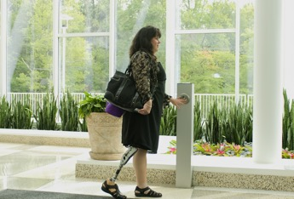


CONSIDERATION 6: Have a Plan for Telling Others About the Accommodation
19

Slide 20

Post-Leave: What is the Return-to-Work Process and Exceptions to Return-to-Work
20

Slide 21



Employer Tips: How to Avoid Retaliation Claims

Slide 22

For More Information
JESSICA ROE
Roe Law Group, PLLC
60 South Sixth Street, Suite 2630
Minneapolis, MN 55402
612-351-8305 (direct)
jroe@roelawgroup.com
www.roelawgroup.com
These materials are for informational purposes only and should not be used as legal advice.
22

